Slide 1
COMP5331 Project
Exploring Current Models on Visual Information for Fake News Detection
Group 14 Type: Implementation
CHENG, Tat Fan
GUPTA, Ayush
LIU, Songyu
LUNG, Kun Hung
YAN, Chiu Wai
Presented by
CHENG Tat Fan

Slide 2
Overview
Introduction & Dataset
Background, Previous work, Objectives, Datasets
Implementation & Results
Baseline models, the full MVNN model and its child models
Conclusion
Presented by
CHENG Tat Fan

Slide 3










Background
Exponential growth of online news media
More accessible, interactive and vivid news
Downplay the role of traditional news reporting
Apart from these, networking platforms become convenient places for sharing news.
In the old times: newspapers, TV, radio, etc.
Presented by
CHENG Tat Fan
Notes:
https://www.freepik.com/premium-vector/tv-news-studio-with-broadcaster-breaking-world-background-vector-illustration_4325738.htm

Slide 4
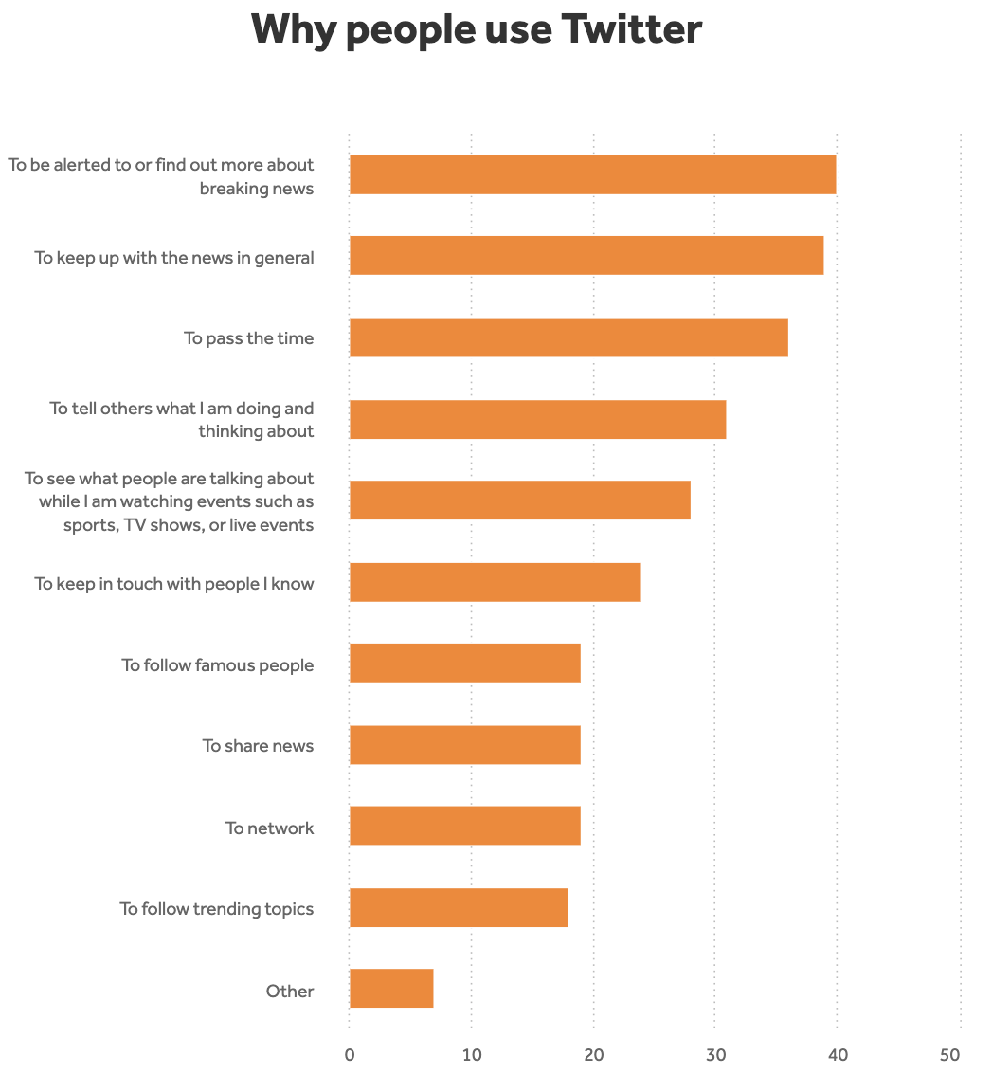
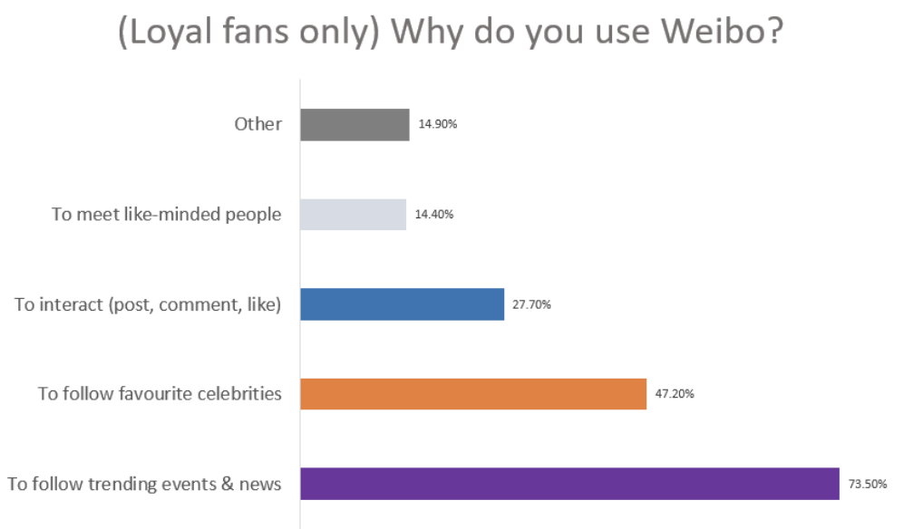
Twitter and Weibo are popular platforms for seeking & sharing news, but also a breeding ground for fake news & rumor
Presented by
CHENG Tat Fan
https://www.americanpressinstitute.org/publications/reports/survey-research/how-people-use-twitter-news/single-page/
https://www.sekkeistudio.com/blog/2016-weibo-user-research-report/

Slide 5
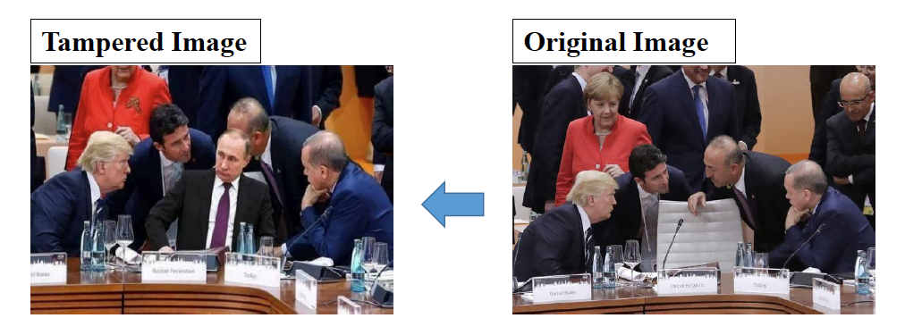
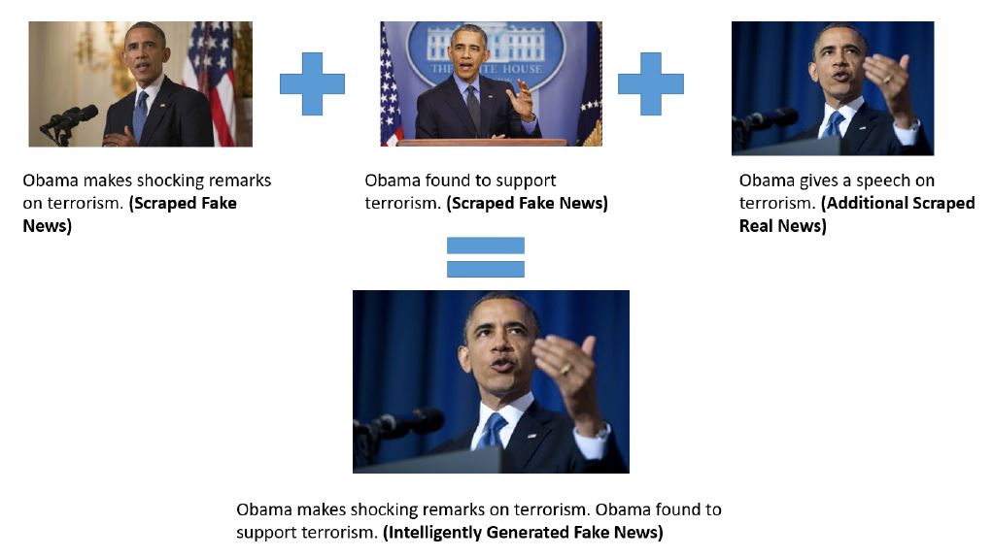
Features of fake news
Tempered images
Misleading images
Real images but with misleading text
(Qi et al. 2019)
Presented by
CHENG Tat Fan
(Jindal et al. 2020)

Slide 6
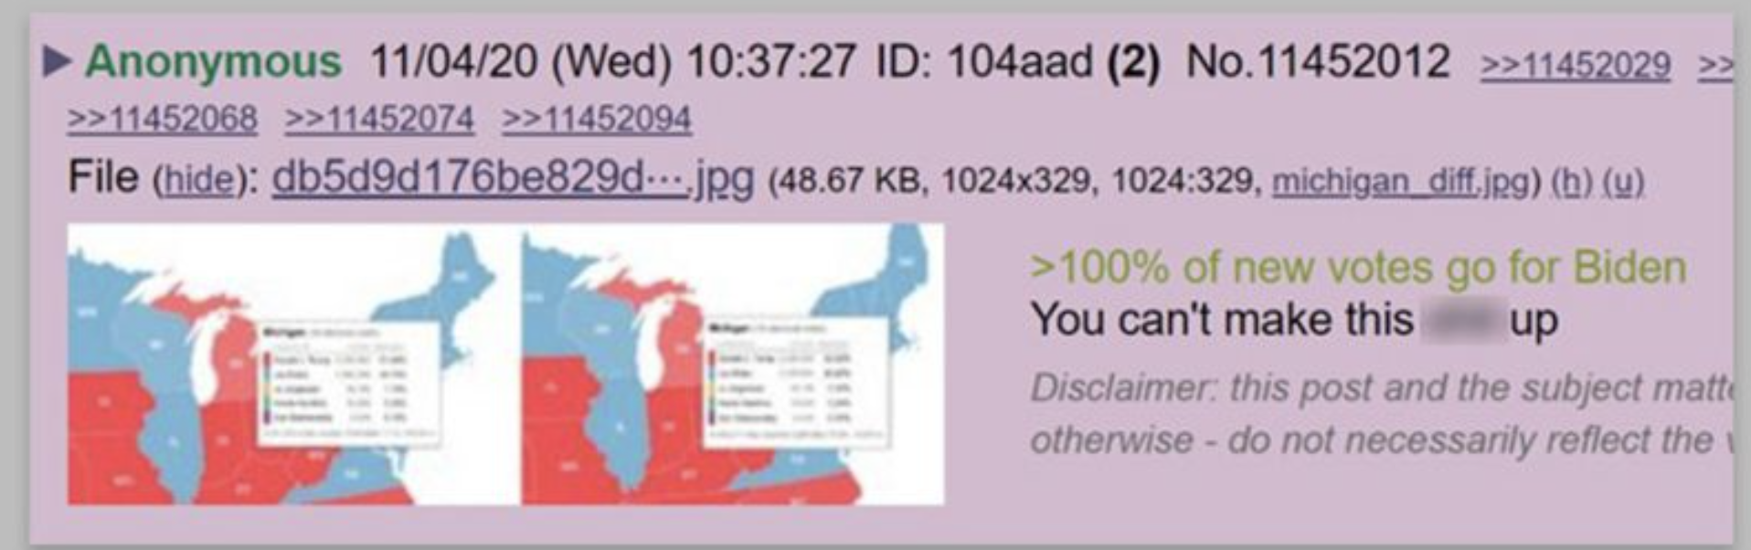
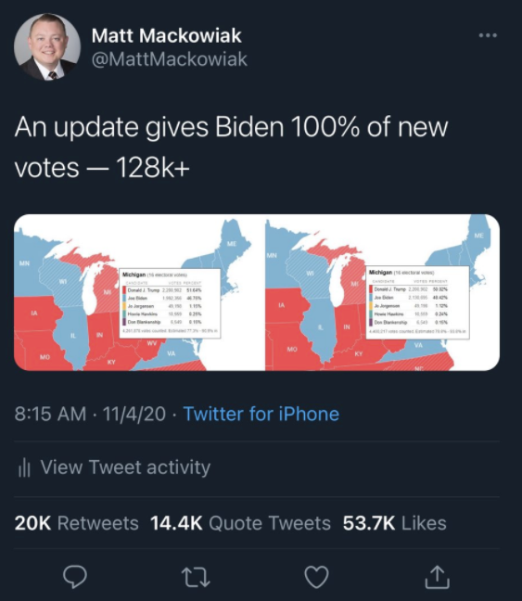
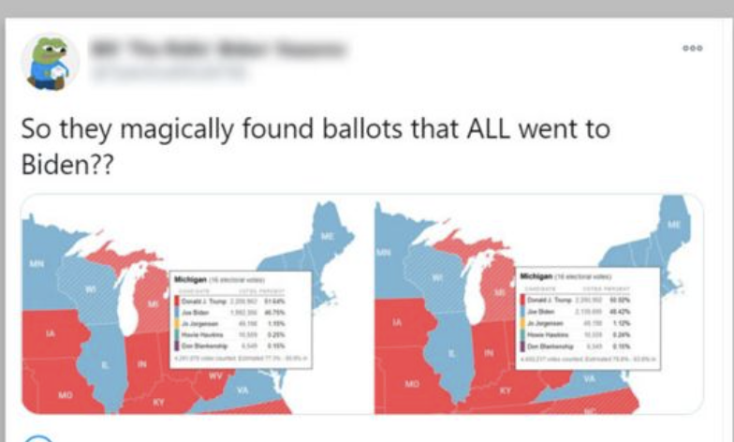
A real-world example
About the Michigan voting map in US Election 2020
A sudden increase of 128k+ votes for Joe Biden, but none for President Trump.
It turns out to be an vote count updated after correcting a data entry error.
But the image was used to advocate a vote fraud in the election
It first appeared on a message board called “8kun” → Twitter and was retweeted by a conservative commentator.
The post went viral even after the original tweet was deleted.
Presented by
CHENG Tat Fan
Sources: https://www.bbc.com/news/election-us-2020-54838684
https://www.bbc.com/news/election-us-2020-54811410

Slide 7
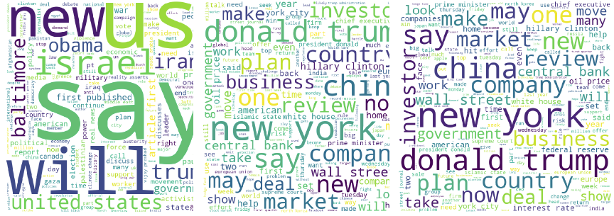
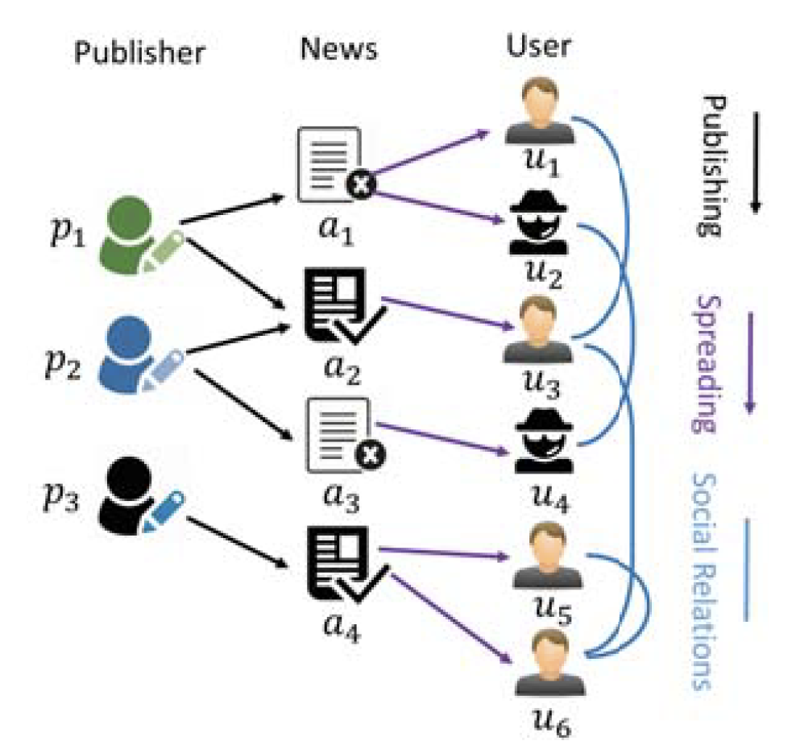
Previous work
Natural language processing (kwon et al. 2013)
Eye-catching or negative words
Hard to mine the discriminative textual features (Jindal et al. 2020)
Relationship between the publisher, news and users (Shu et al. 2018)
(Jindal et al. 2020)
Presented by
CHENG Tat Fan
(Shu et al. 2018)

Slide 8
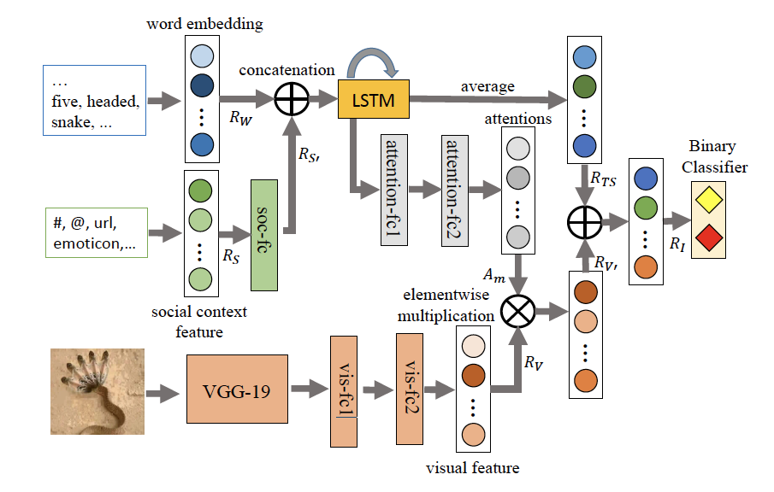
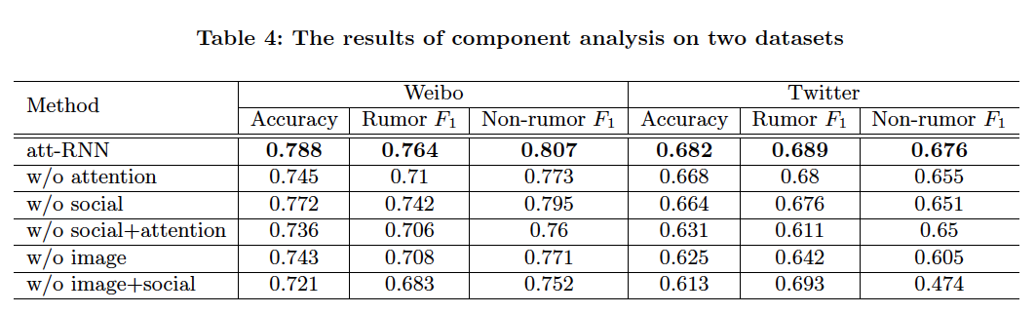
Previous work
RNN with an attention mechanism (att-RNN) (Jin et al. 2017)
Fusion of the image, textual and social context features extracted by VGG and LSTM
78.8% accuracy
(Jin et al. 2017)
Presented by
CHENG Tat Fan

Slide 9
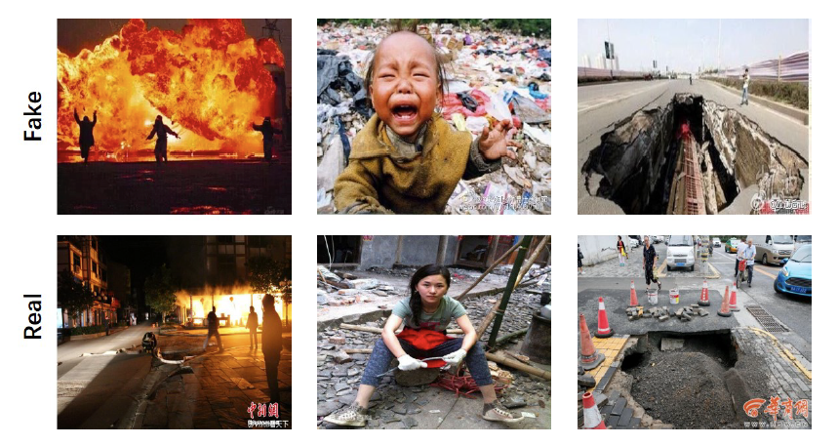
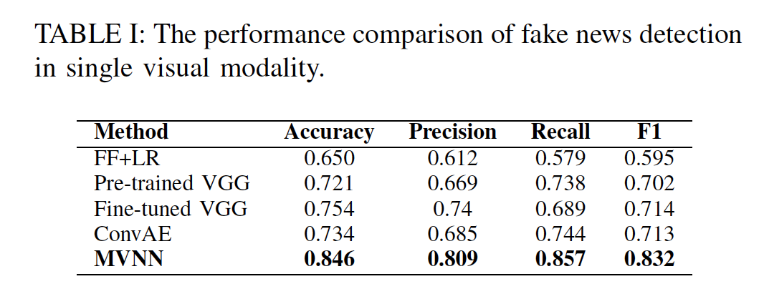
Previous work
Multi-domain Visual Neural Network (Qi et al. 2019)
CNN & GRU to mine image features in
frequency domain (re-compression/low image quality)
pixel domain (emotional/eye-catching)
84.6% accuracy (on the same datasets as Jin et al. 2017)
This MVNN model is implemented in our project.
(Qi et al. 2019)
Presented by
LIU Songyu

Slide 10
Introduction - Objectives
Use MVNN to extract visual features from different domains and merge them using attention
Compare the performance of MVNN with other baselines
Presented by
LIU Songyu

Slide 11
Introduction - Objectives
Test the performance of the MVNN model with parts of it removed
Tune hyper parameters
Presented by
LIU Songyu

Slide 12
Datasets
Weibo Dataset (This is the one we used for training)
Twitter Dataset (not used)
Presented by
LIU Songyu

Slide 13
The Twitter Dataset
Roughly 350 Images.
Too small for Deep learning
Presented by
LIU Songyu

Slide 14
MM17-WeiboRumorSet
[nonrumor_images]: 5318 images.
[rumor_images]: 7954 images.
Total no. of images: 13272
Large enough for Deep learning.
Presented by
LIU Songyu

Slide 15
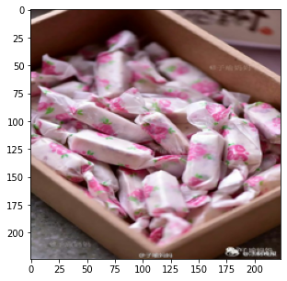
Non rumor
Presented by
LIU Songyu

Slide 16
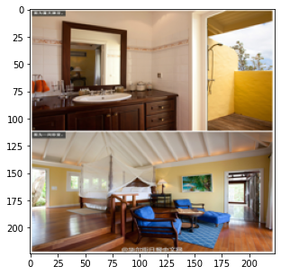
Presented by
LIU Songyu

Slide 17
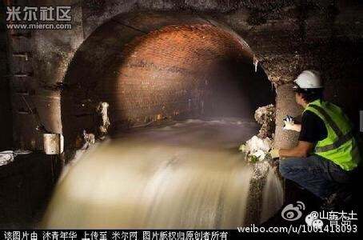
Rumor
Presented by
LIU Songyu

Slide 18
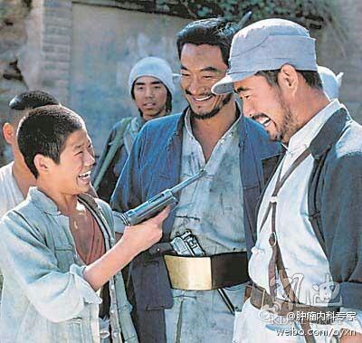
Presented by
LIU Songyu

Slide 19
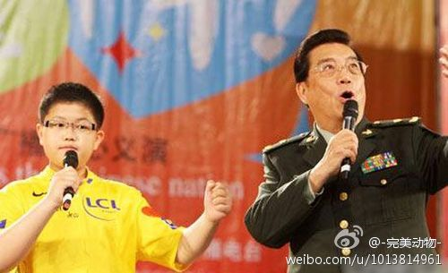
Presented by
LIU Songyu

Slide 20
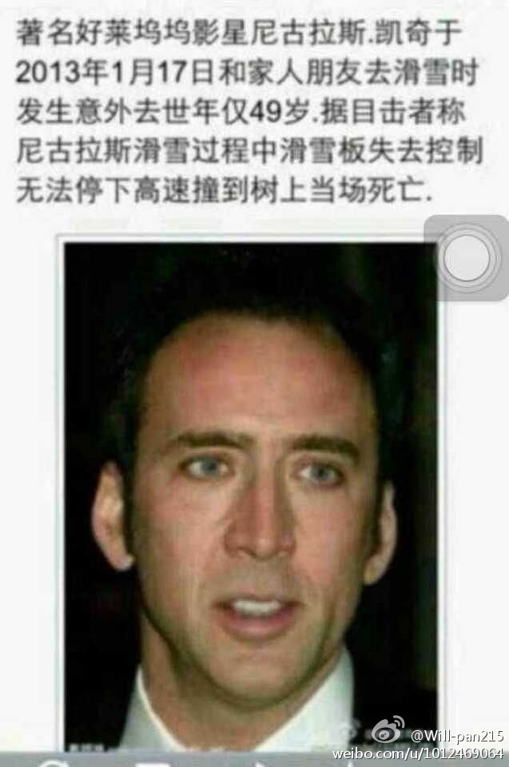
Presented by
LIU Songyu
Notes:
Pictures are resized in preprocessing

Slide 21
Methodology - Implementation
Python, Google Colab GPU
Baseline Models
VGG-16 VGG-19
Simple Sequential model of CNN
MVNN based models from paper [1]
Frequency based - Attention
Pixel based - Full MVNN
Presented by
GUPTA Ayush

Slide 22
Baseline Models
VGG-16
VGG-19
Sequential model of CNN
Presented by
GUPTA Ayush

Slide 23
Baseline Models
VGG-16 & VGG-19 - popular models
Pre-trained on ImageNet
Fine tuned on Weibo data set
Presented by
GUPTA Ayush

Slide 24

Baseline Model - VGG-16
Presented by
GUPTA Ayush
Image from Researchgate.net

Slide 25
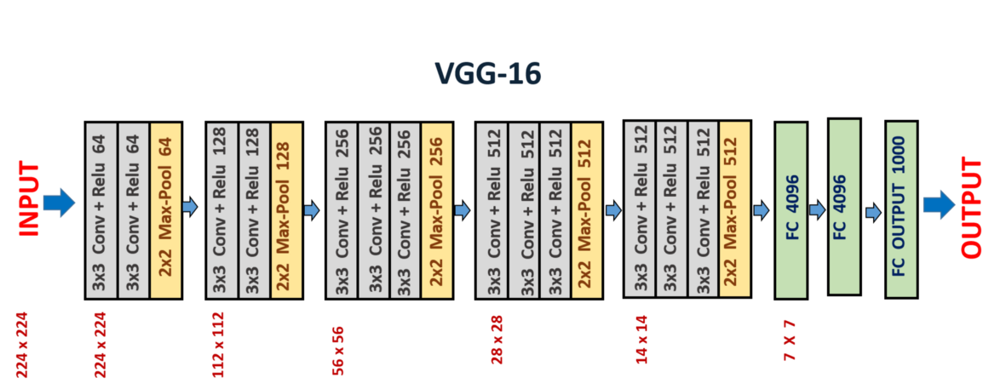
Baseline Model - VGG-16
Presented by
GUPTA Ayush
Image from Researchgate.net

Slide 26
Simple Sequential model of CNN
Simplified version of VGG-16
2D CNN, ReLu activation,
Batch Normalization, MaxPooling2D, Dropout layers
Fully Connected layer
Presented by
GUPTA Ayush

Slide 27
Simple Sequential model of CNN
Architecture:
Conv2D, BatchNorm, MaxPool2D, Dropout, Conv2D, BatchNorm, MaxPool2D, Dropout
126*126*32, 126*126*32, 63*63*32, 63*63*32, 61*61*64, 61*61*64, 30*30*64, 30*30*64
Fully Connected (FC) - Flatten, Dense, BatchNorm, Dropout, Dense
No.: 57600, 512, 512, 512, 512
No of layers of CNN: 1,2,3,4. Hyperparameter tuning.
2 found as best.
Presented by
GUPTA Ayush

Slide 28
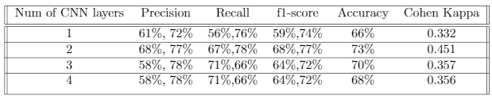
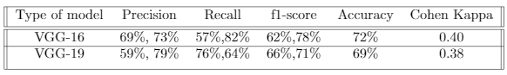
Results - Baseline Model
Simple Sequential model of CNN:
VGG:
Presented by
GUPTA, Ayush

Slide 29
MVNN - Overview
Implemented based on Paper [1]
Multi-domain Visual Neural Network (MVNN) framework
Frequency - DCT (Discrete Cosine Transform) - CNN
Pixel - CNN-RNN-GRU
Attention - Combine the above, Train
Full model
Presented by
GUPTA Ayush

Slide 30
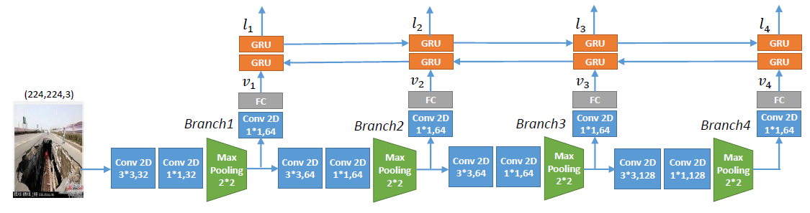
MVNN - Pixel Domain
4-branch CNN-RNN
Extract feature at each semantic level
Bi-GRU (Bidirectional GRU)
Input: 4 32-vectors
Output 4 64-vectors , where
Presented by
YAN Chiu Wai

Slide 31
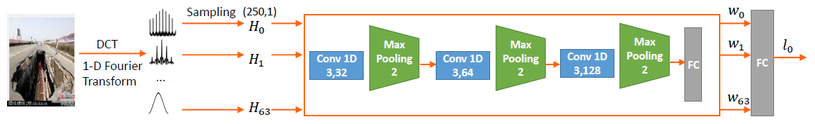
MVNN - Frequency Domain
Idea: JPEG images produce traces during re-compression, which can be detected by examining its 8x8 DCT Blocks [5]
Preprocess data:
Reshape into (128, 128, 3), in YCbCr channels
8x8 DCT (Discrete Cosine Transform)
Backbone: 1D Convolutional Neural Network
Presented by
YAN Chiu Wai

Slide 32
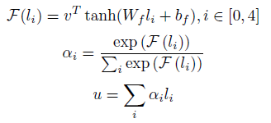
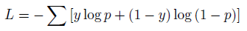
MVNN - Attention
Idea: Let the model decide which feature should contribute more to the final result depending on the situation
Previous outputs: 5 64-vectors of features
4 from pixel domain, 1 from freq. domain
Output u, a single 64-vector
FC layer with softmax activation outputting 2 logits: P(FAKE) and P(REAL)
Loss function: cross-entropy loss
v is a weight vector (parameter to learn)
F is the score function evaluating significance of a feature vector
a_{i} is the final weight assigned to each vector
u is the output 64-vector
Presented by
YAN Chiu Wai

Slide 33
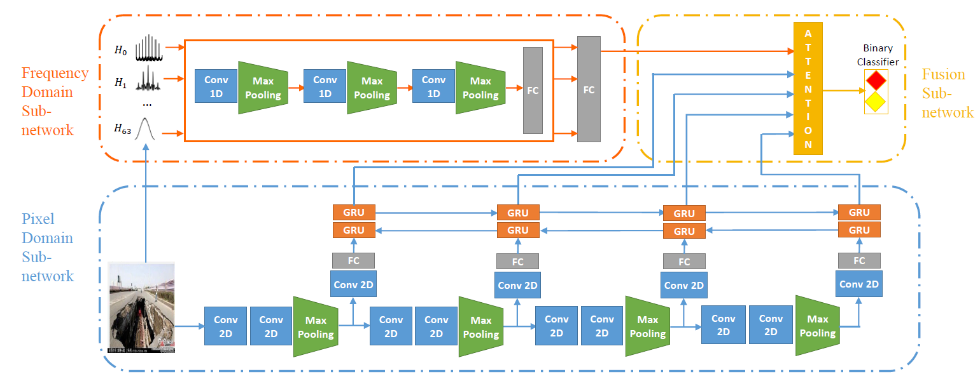
MVNN - Full
Presented by
YAN Chiu Wai

Slide 34
Results - Metric
Precision
Recall
f1-score
Accuracy
Presented by
Lung Kun Hung Eric

Slide 35
Results - Metric
Cohen Kappa
measure inter-rater reliability for qualitative items
consensus exists in the ratings given by various judges
< 0.00 | Poor
0.00 - 0.20 | Slight
0.20 - 0.40 | Fair
0.40 - 0.60 | Moderate
0.60 - 0.80 | Substantial
0.80 - 1.00 | Almost perfect
Presented by
Lung Kun Hung Eric

Slide 36
Results - Baseline Model
Simple Sequential model of CNN:
VGG:
Presented by
Lung Kun Hung Eric

Slide 37
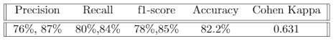
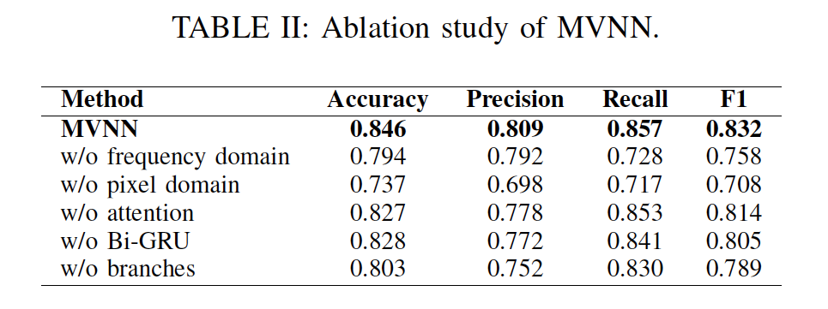
Results - MVNN Final
Presented by
Lung Kun Hung Eric

Slide 38
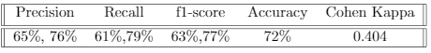
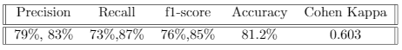
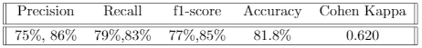
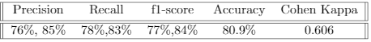
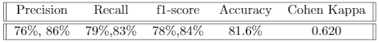
Results - MVNN Variations
w/o pixel domain
w/o frequency domain
w/o attention
w/o GRU
w/o branches
Presented by
Lung Kun Hung Eric

Slide 39
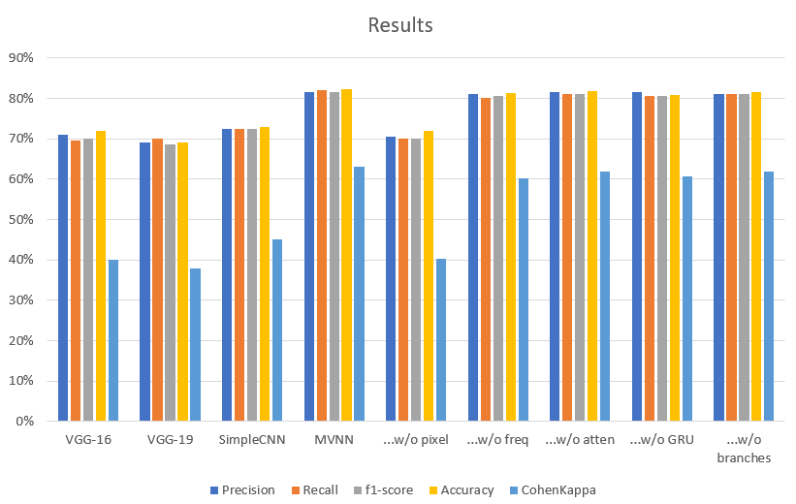
Presented by
Lung Kun Hung Eric

Slide 40
Conclusion
Baseline Models
MVNN
High accuracy (>80%)
Pixel domain is strongly correlated to MVNN
Compare the result statistics
Presented by
Lung Kun Hung Eric

Slide 41
Conclusion
Stronger units: The Use of GRU can be replaced by more sophisticated architecture like LSTM or even TRANSFORMER
Dataset: Also including the TEXT part since fake news detection depends a lot in the actual text describing the image
More preprocessing: haven’t test data augmentation due to the assumption on JPEG image (which is found to be not the most helpful)
Transfer learning: use existing convolution parameters instead of training from scratch and using randomly initialized weights
Presented by
Lung Kun Hung Eric

Slide 42
Thank you! :-)
Any questions for us?

Slide 43
References
P. Qi, J. Cao, T. Yang, J. Guo, and J. Li. Exploiting multi-domain visual information for fake news detection. In 2019 IEEE International Conference on Data Mining (ICDM), pages 518–527, 2019.
Chen, Yi-Lei and Chiou-Ting Hsu. Detecting recompression of jpeg images via periodicity analysis of compression artifacts for tampering detection. IEEE Transactions on Information Forensics and Security, 6:396–406, 062011
Jin, Zhiwei, Juan Cao, Han Guo, Yongdong Zhang, and Jiebo Luo. Mul-timodal fusion with recurrent neural networks for rumor detection on microblogs. In Proceedings of the 25th ACM international conference on Multimedia, pages 795–816. ACM, 2017.
Jindal, Sarthak, Raghav Sood, R. Singh, Mayank Vatsa, and Tanmoy Chakraborty. Newsbag: A benchmark multimodal dataset for fake news detection. In SafeAI@AAAI, 2020.
Kwon, Sejeong, Meeyoung Cha, Kyomin Jung, Wei Chen, and Yajun Wang. Prominent features of rumor propagation in online social media. In 2013 IEEE 13th International Conference on Data Mining, pages 1103–1108. IEEE, 2013.
Shu, Kai, Suhang Wang, and Huan Liu. 2019. Beyond News Contents: The Role of Social Context for Fake News Detection. In Proceedings of the Twelfth ACM International Conference on Web Search and Data Mining (WSDM '19). Association for Computing Machinery, New York, NY, USA, 312–320. DOI:https://doi.org/10.1145/3289600.3290994

Slide 44
Additional information - Appendix
Possible questions
Did we implement paper’s model successfully?
How good is our implementation w.r.t. Paper’s?

Slide 45
VGG-16
https://medium.com/towards-artificial-intelligence/the-architecture-and-implementation-of-vgg-16-b050e5a5920b
VGG19 is a variant of VGG model which in short consists of 19 layers (16 convolution layers, 3 Fully connected layer, 5 MaxPool layers and 1 SoftMax layer).
Presented by
GUPTA, Ayush

Slide 46
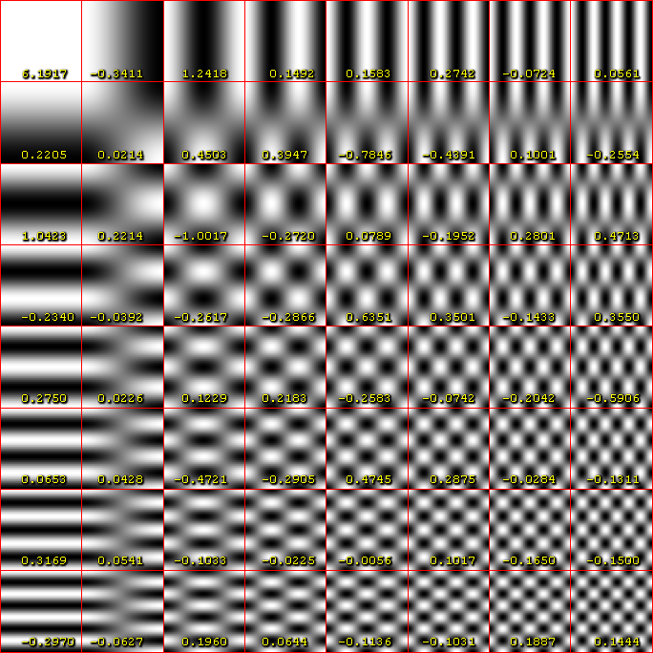
DCT in Frequency Domain
A discrete cosine transform expresses a finite sequence of data points in terms of a sum of cosine functions oscillating at different frequencies. The DCT, first proposed by Nasir Ahmed in 1972, is a widely used transformation technique in signal processing and data compression.
Source: Wikipedia
Presented by
GUPTA, Ayush

Slide 47
Hyper-parameters used in MVNN training
Images are resized to
128*128 for the frequency subnetwork
224*244 for the pixel subnetwork
80% training and 20% validation (Weibo dataset)
Learning rate = 0.0001 (best rate for converging the loss)
Batch size = 32
Cross-entropy Loss with the Adam optimizer (Qi et al., 2019)
Dropout probability = 0.5 (Qi et al., 2019)
No. of branches in pixel = 4 (suggested by Qi et al., 2019)
Prepared by
CHENG Tat Fan

Slide 48
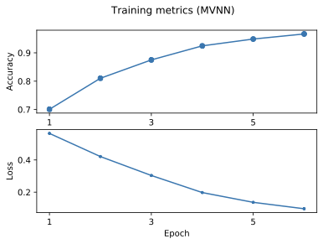
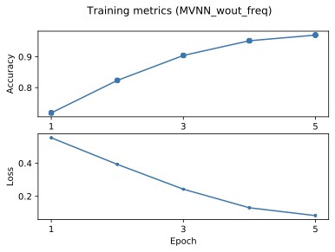
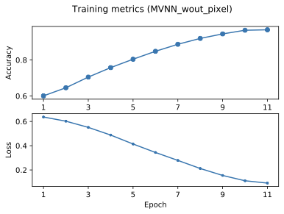
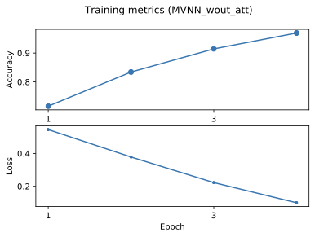
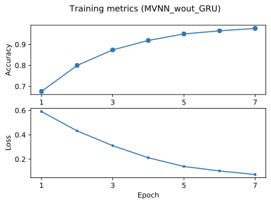
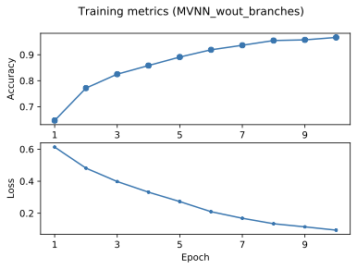
Training time
Training time per epoch (on GRU):
4-5 mins for all MVNN models
Prepared by
CHENG Tat Fan

Slide 49
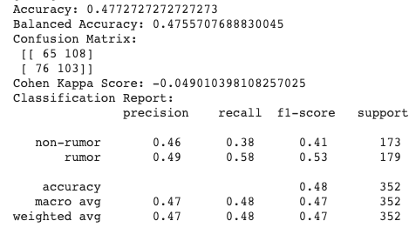
Using trained MVNN on a completely new set
Twitter image dataset (360 images)
The performance is not good
Two completely different *cultures*
Different features of fake news
Weibo → tempered/exaggerated images
Twitter → misleading texts with real/misleading images
Overfitting of the model
Although we have an early stopper for training (when loss < 0.1)
Dropout layers (p = 0.5)
Prepared by
CHENG Tat Fan

Slide 50
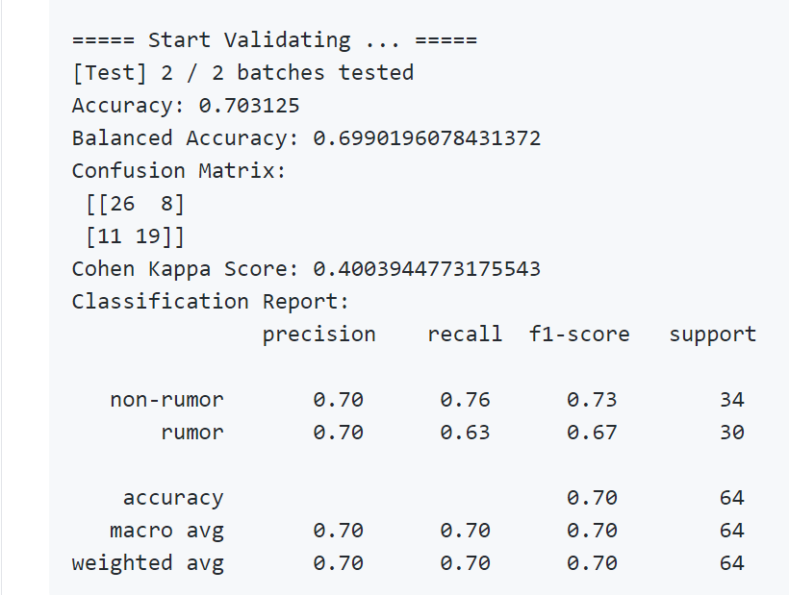
Training full MVNN on a completely new set
Twitter image dataset (360 images)
The performance is decent
Prepared by
Liu songyu

